Slide 1

ML Unsupervised – Capstone Project
NETFLIX MOVIES AND TV SHOWS CLUSTERING
Abhishek Kumar
Mohita Rathour

Slide 2
Introduction
Netflix is the world's leading streaming entertainment service with over 209 million paid memberships in over 190 countries enjoying TV series, documentaries and feature films across a wide variety of genres and languages. Members can watch as much as they want, anytime, anywhere, on any internet-connected screen. Members can play, pause and resume watching at any time.
This dataset consists of tv shows and movies available on Netflix as of 2019. The dataset is collected from Flixable which is a third-party Netflix search engine.
In 2018, they released an interesting report which shows that the number of TV shows on Netflix has nearly tripled since 2010. The streaming service’s number of movies has decreased by more than 2,000 titles since 2010, while its number of TV shows has nearly tripled.
In this project, you are required to do
Exploratory Data Analysis
Understanding what type content is available in different countries
Is Netflix has increasingly focusing on TV rather than movies in recent years.
Clustering similar content by matching text-based features

Slide 3
Workflow
Raw Data
Data Manipulation
Feature Engineering
Unsupervised
Algorithms
New Data
Cluster 1
Evaluation
Model
Cluster 2
Cluster 3
Cluster 4
Predictions

Slide 4
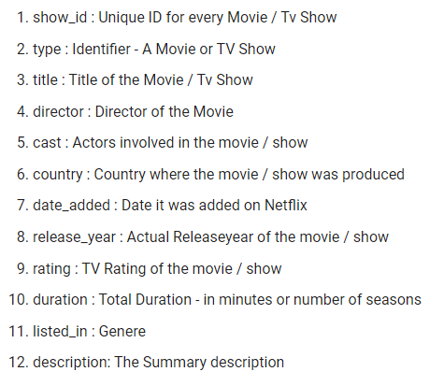
Attributes

Slide 5
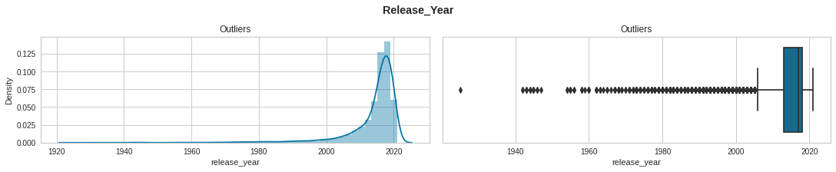
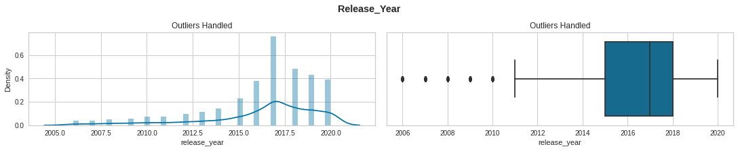
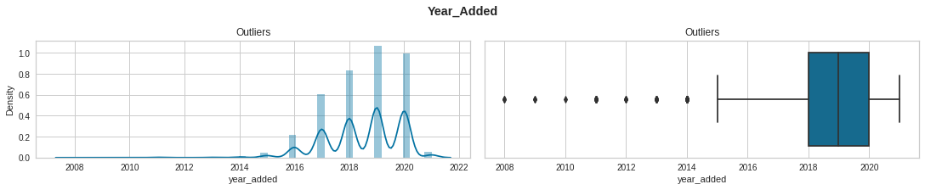
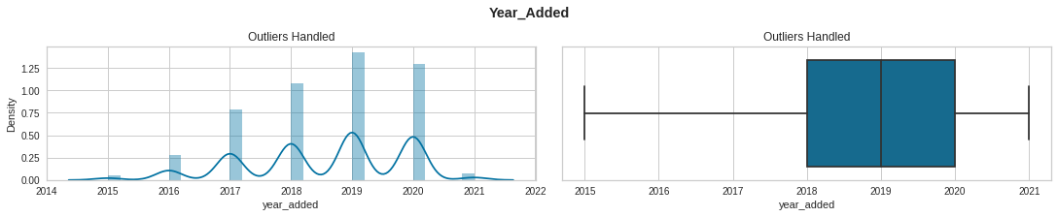
Handling Outliers

Slide 6
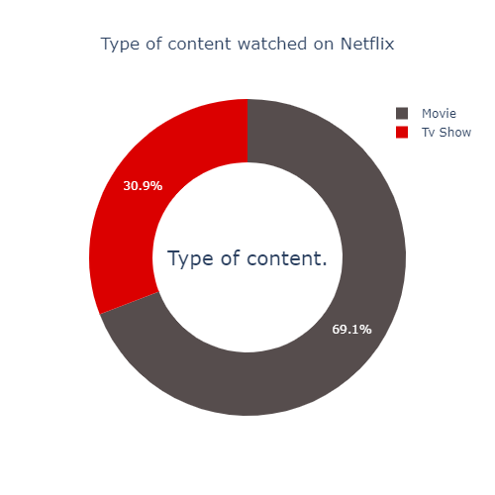
Type of Content on Netflix
69.1% of the content available on Netflix are movies and the remaining 30.9% are TV Shows

Slide 7
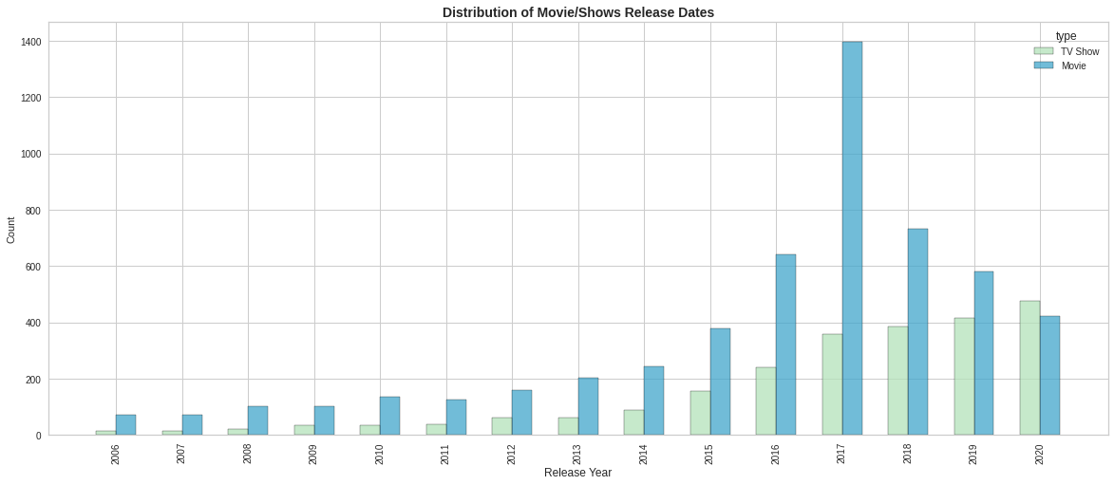
Release year of Movies/TV Shows
Maximum number of Movies streaming on the platform were released in 2017.
Most TV Shows streaming on the platform were released after 2015
Since the number of movies releasing each year has started decreasing after 2017 whereas number of TV Shows have increased gradually after 2015.

Slide 8
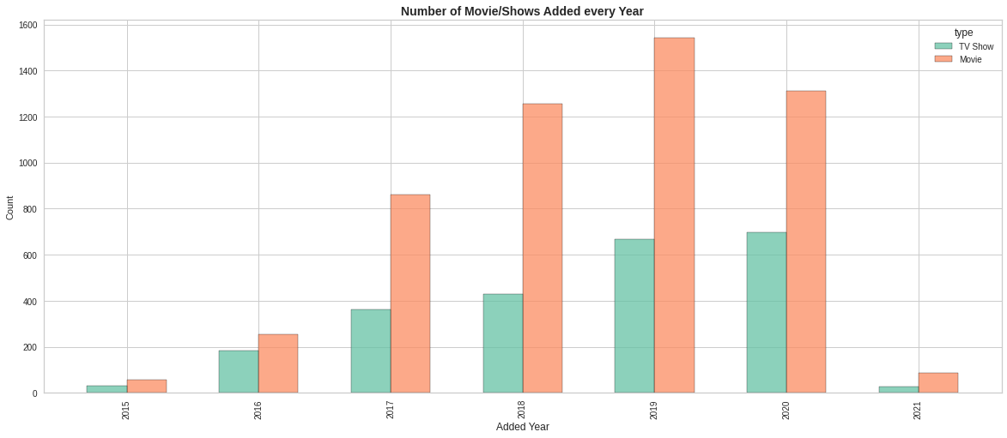
Number of Movies/TV Shows added per Year
Number of movies added to the platform showed a deliberate increase after 2017 to 2019 and has been decreased after that.
Whereas TV Shows have been added continuously from 2015 and its number been increased every year.

Slide 9
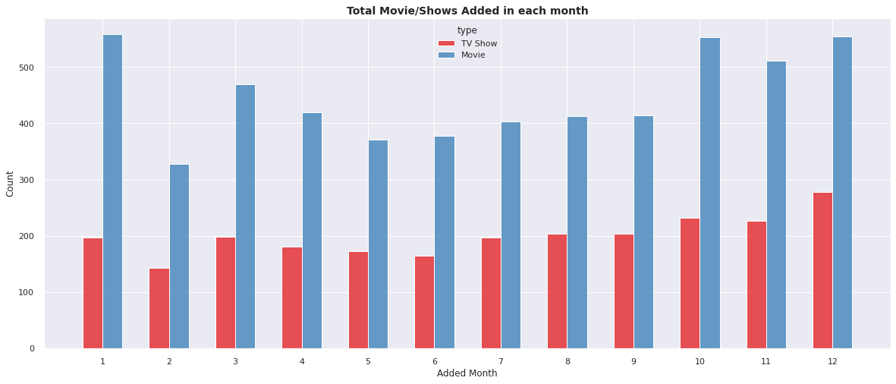
Number of Movies/TV Shows added per Month
Most number of Movies and TV Shows are added between October and January

Slide 10
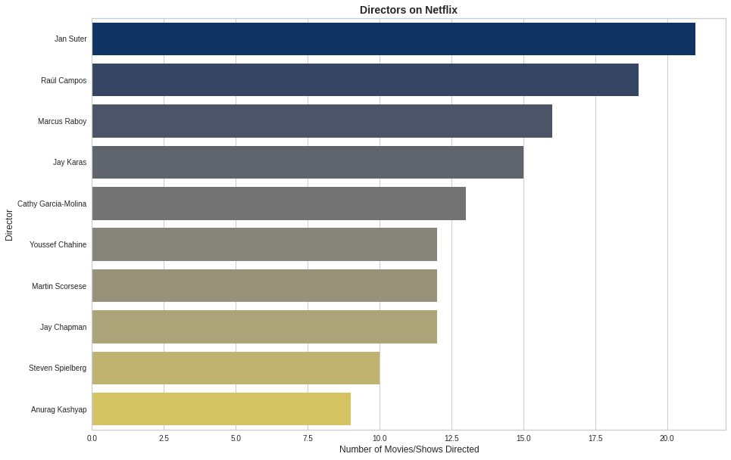
Top 10 Directors
Top 10 Directors are-
Jan Suter
Raul Campos
Marcus Raboy
Jay Karas
Cathy Garcia Molina
Youssef Chahine
Martin Scorsese
Jay Chapman
Steven Spielberg
Anurag Kashyap

Slide 11
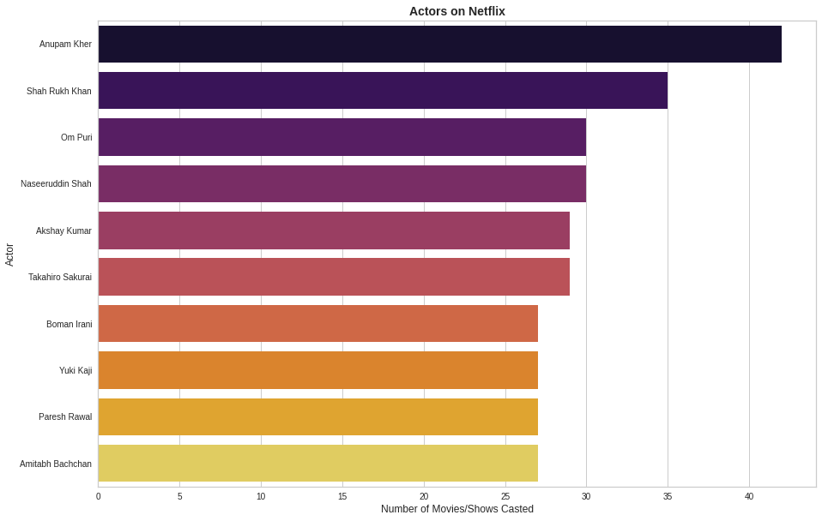
Top 10 Actors
Top 10 Actors are-
Anupam Kher
Shah Rukh Khan
Om Puri
Naseeruddin Shah
Akshay Kumar
Takahiro Sakurai
Boman Irani
Yuki Kaji
Paresh Rawal
Amitabh Bachchan

Slide 12
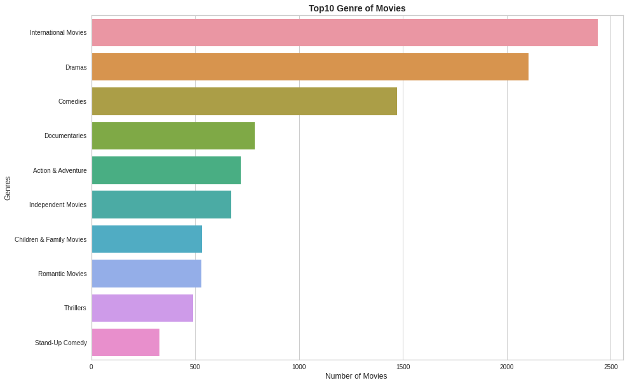
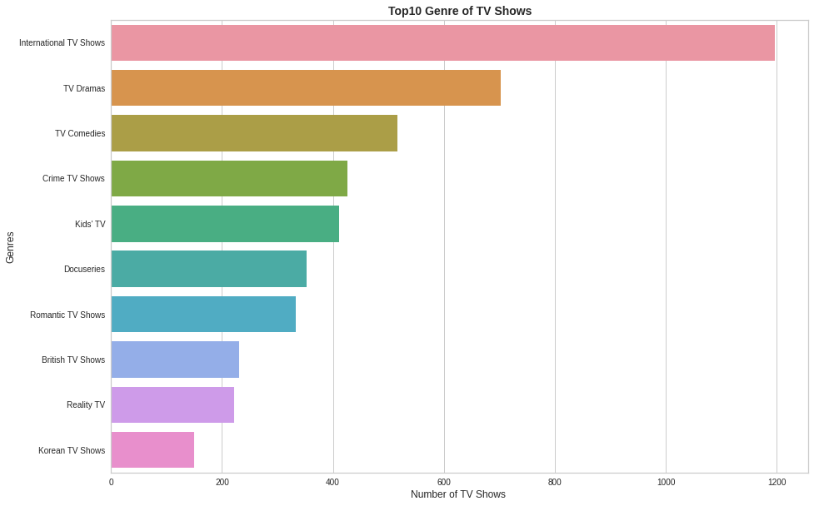
Top Genres of Netflix
In both Movies and TV Shows top genres are International Movies/Shows, Dramas and Comedies.

Slide 13
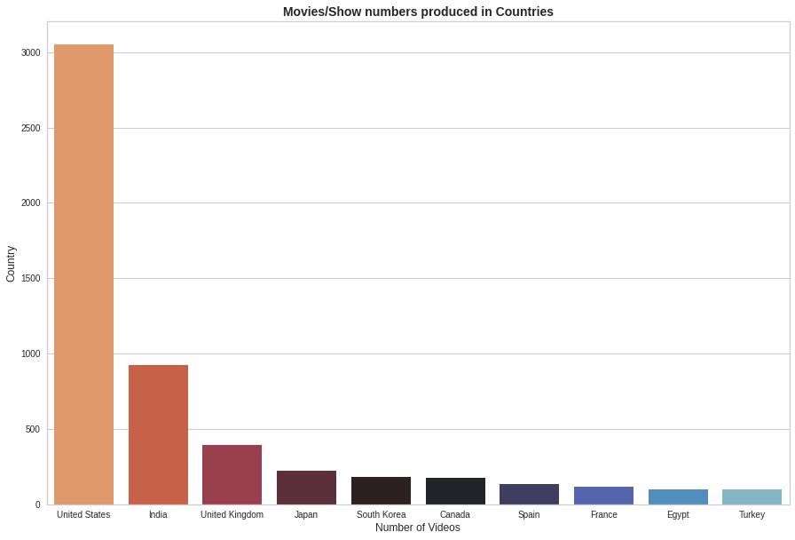
Top 10 Countries producing content on Netflix
United States is the country producing maximum content on Netflix followed by India and UK.

Slide 14
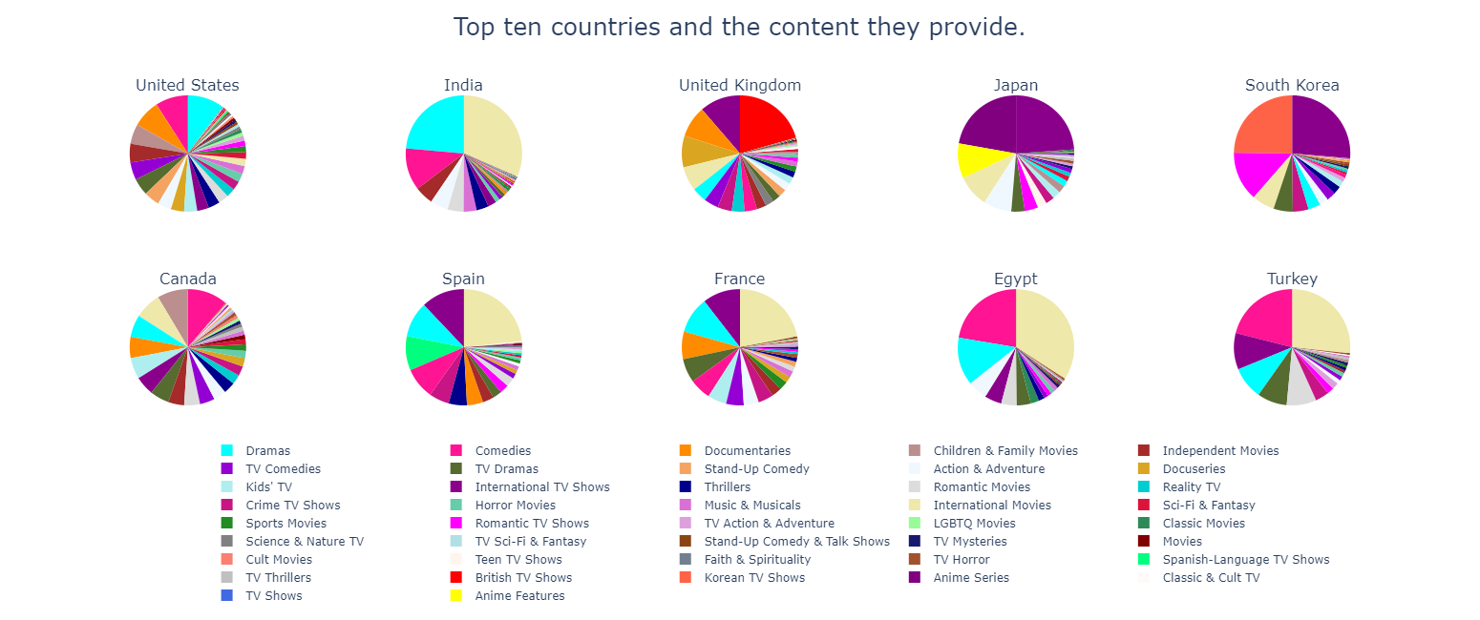
What Type of content produced by Top 10 Countries
Drama, International Movies, and Comedies seem popular choices in most countries.
British and International Tv Shows dominate in the United Kingdom.
Regional specialties such as Anime in Japan, Spanish TV Shows in Spain and Korean Tv Shows in South Korea are more prominent in these countries.
It is also observed that in the countries where the regional language is not English, International Tv Shows/Movies are more in demand.

Slide 15
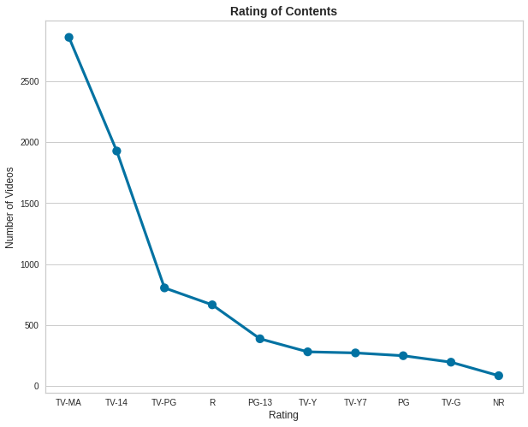
Ratings of content
Netflix Rating of Movies/TV Shows based on content:-
TV-MA : for Mature Audiences
R : Restricted*
PG-13 : Parents strongly cautioned. May be Inappropriate for ages 12 and under
TV-14 : Parents strongly cautioned. May not be suitable for ages 14 and under
TV-PG : Parental Guidance suggested
NR : Not Rated
TV-G : Suitable for General Audiences
TV-Y : Designed to be appropriate for all children
PG : Parental Guidance suggested
G : Suitable for General Audiences
NC-17 : the content isn't suitable for children under 17 and younger
TV-Y7-FV : Suitable for ages 7 and up
Most content on Netflix is rated for Mature Audiences(MA) and over 14 years old

Slide 16
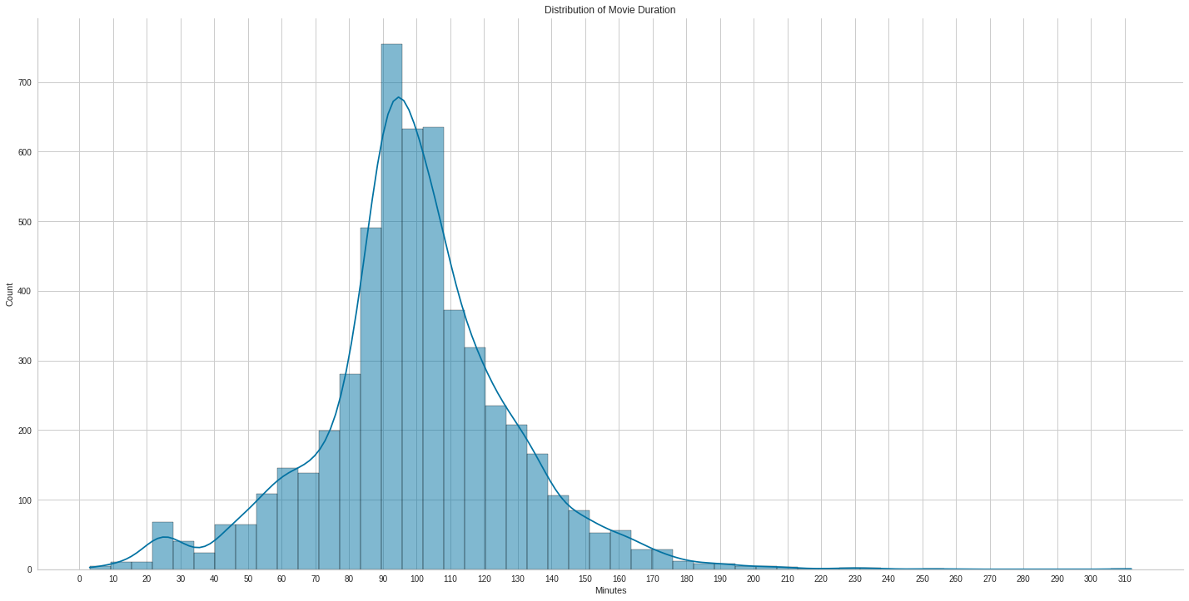
Duration of Movies
Most movies on Netflix have a duration range from 80 to 120 minutes

Slide 17
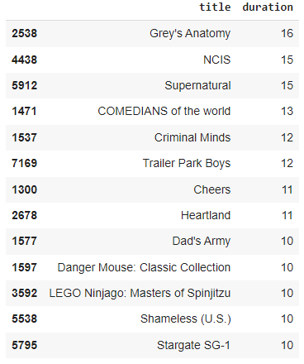
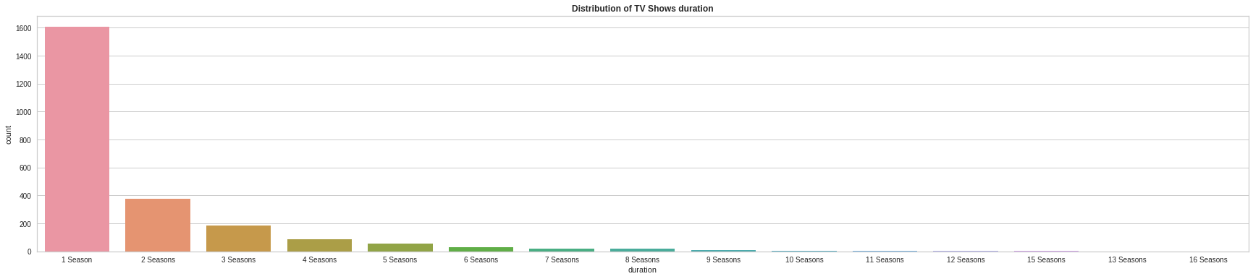
Seasons of TV Shows Longest TV Shows
More number of TV shows are having single season
Grey's Anatomy is the longest TV Show with 16 Seasons

Slide 18
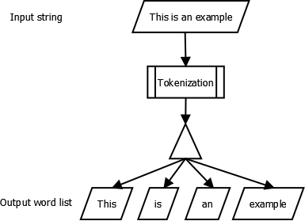
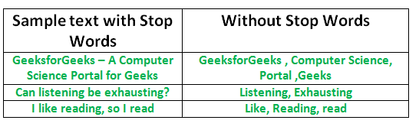
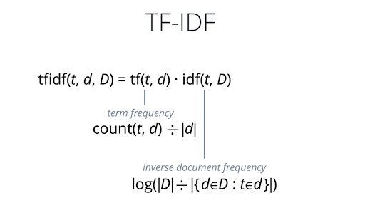
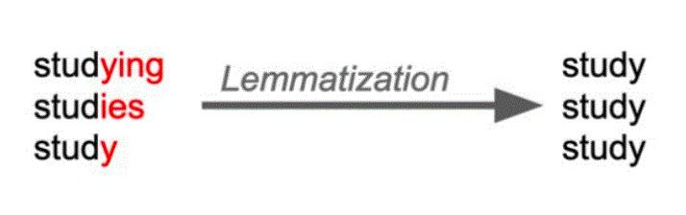
Feature Engineering
Tokenization- Tokenization is method used for parsing a large amount of textual data into parts to perform an analysis of the character of the text.
Lemmatization- Lemmatization is a text normalization technique used in Natural Language Processing (NLP), that switches any kind of a word to its base root mode.
Stop Words Removal- Stop words removal is the data pre-processing step in which we remove all the highly frequent words from the text that doesn’t add any valuable information to understand the text better resulting in the NLP model dealing with less number of features.
TF-IDF(Term Frequency-Inverse Document Frequency)- Term Frequency - Inverse Document Frequency is a 2 dimensional data matrix where each term denotes the relative frequency of a particular word in a particular document as compared to other documents.

Slide 19
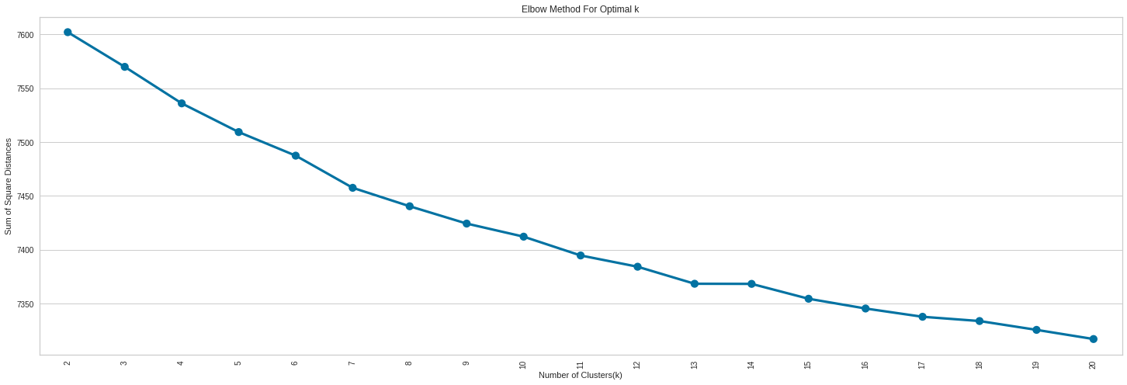
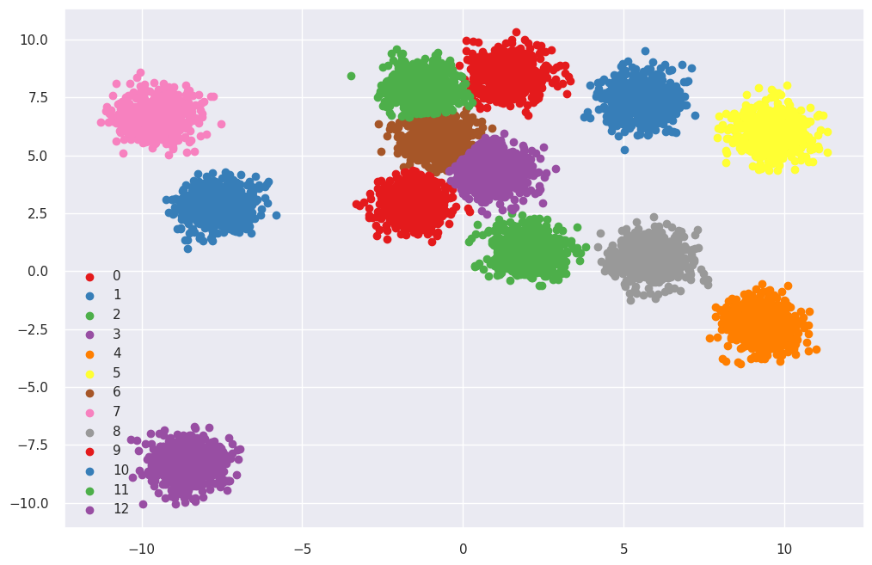
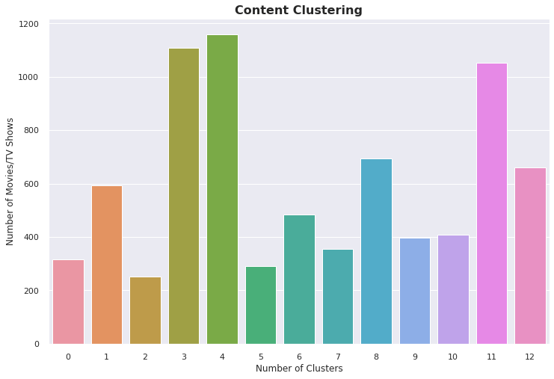
K-Means Clustering
From Silhouette Analysis and Elbow method, the optimal cluster is 13. This gives a clustering score of 0.012.

Slide 20
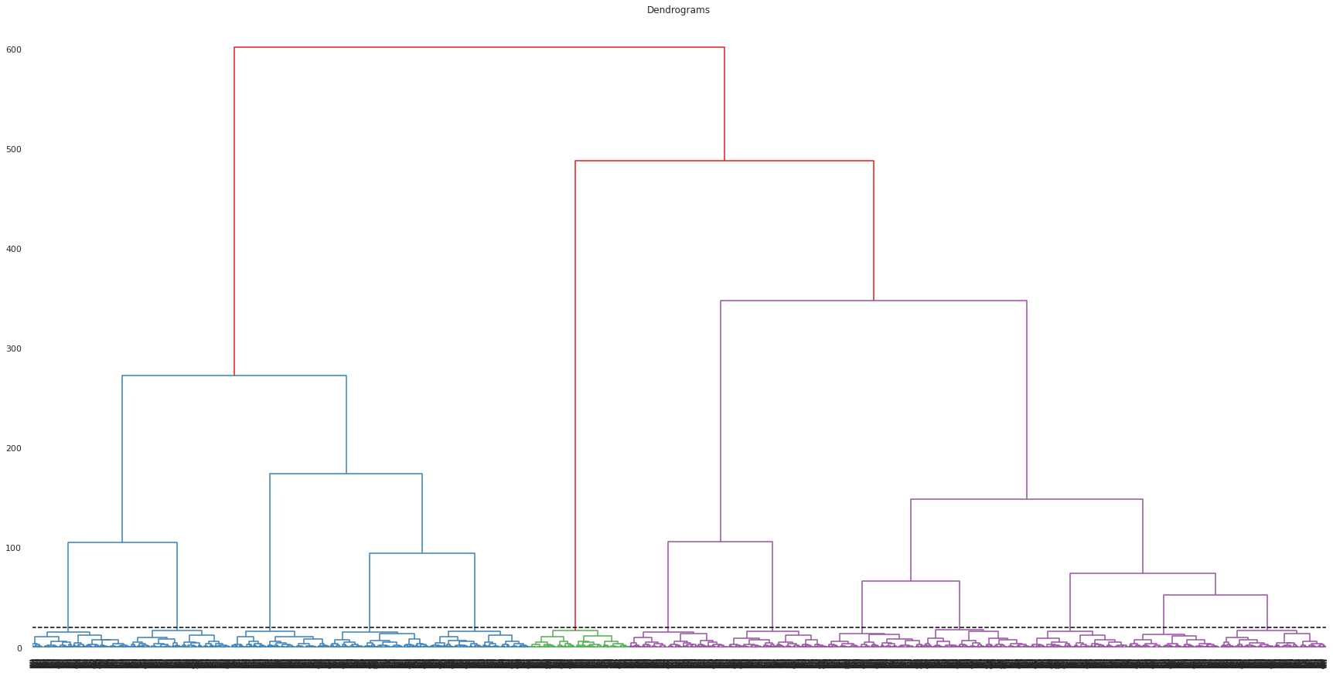
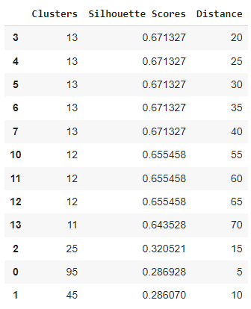
Hierarchical Clustering
Highest Silhouette Score of 0.671327 achieved at distance = 20 with 13 clusters

Slide 21
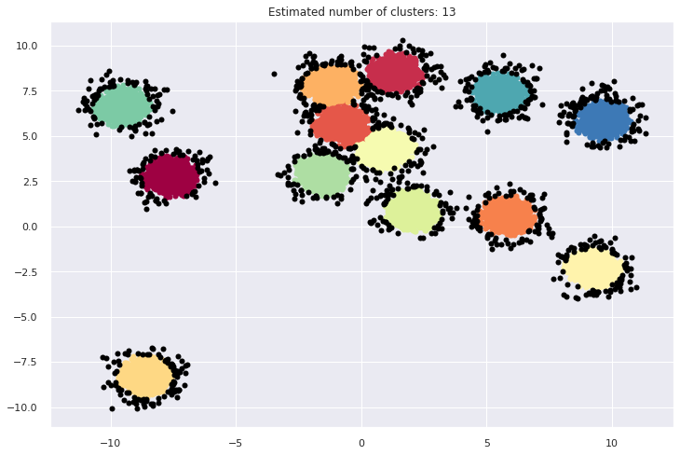
DB SCAN
Estimated number of clusters: 13 Estimated number of noise points: 1039

Slide 22
Conclusion
Majority of content on Netflix are movies. Netflix has 5372 movies and 2398 TV shows.
The number of movies on Netflix is growing significantly faster than the number of TV shows.
We saw a huge increase in the number of movies and TV Shows after 2015. Highest number of movies released in 2017.
Less Number of movies released after 2017 whereas more number of TV shows were released in this period.
Most of these contents are released either in the year ending or in the beginning.
International Movies/TV Shows are the top most genre in Netflix which is followed by Drama and Comedy movies/TV shows.
United States is the major content producing country on the platform followed by India, UK, Japan, South Korea.
Jan Suter and Raul Campos have directed the most content on Netflix.
Also 6 of the actors among the top ten actors with maximum content are from India. Anupam Kher, Shah Rukh Khan, Om Puri are top 3 Actors.
TV-MA tops the rating chart, indicating that mature content is more popular on Netflix.
Most of the movies have duration between 80 to 120 minutes.
Most number of TV shows are having single season. Grey's Anatomy is the longest TV Show with 16 Seasons.
k=13 was found to be an optimal value for clusters using which we grouped our data into 13 distinct clusters.

